Slide 1
Deputation to City of Kawartha Lakes City Council
September 18, 2018
Susan Taylor and Dianne Lister

Slide 2
THANK YOU!
We are not here today to ask for money
We are here to THANK OUR MAYOR AND COUNCIL for their support of the Cultural Sector that has brought us to where we are today
and for your time today as we present the choices and partnerships that we can make for the increased economic wellbeing of our community

Slide 3
WHO ARE WE?
ABOUT KAWARTHA LAKES ART COUNCIL
A not for profit organization incorporated in 2014
Vision: to advocate for arts, culture and heritage as economic drivers contributing to the wellbeing of CKL
We partner with the City, Kawartha Lakes Heritage Network and other interested parties A membership of 75 artists and organizations representing over 1,000 residents
Board of 10 volunteers who are artists, business owners and cultural leaders with expertise in business and cultural planning, philanthropy, government and stakeholder relations

Slide 4
Offered numerous educational sessions to community
Initiated “Made in the Kawarthas” annual Arts Show and Sale in November 2017
Re-launched ArtsVote advocacy campaign August 2018
Attracting businesses through our Community Partners sponsorship program
Launching first arts, culture and heritage newsletter in CKL (October)
Our social media platforms are robust and vibrant
We speak for the Arts & Heritage Sector

Slide 5
ABOUT THE CULTURAL CENTRE COMMITTEE
The Cultural Centre Committee is a Special Project Partnership project between the Kawartha Lakes Arts Council and the Kawartha Lakes Heritage Network.
The goals of the committee are:
To represent and strengthen the arts and heritage sectors
Promote the adoption of the Cultural and Heritage Master Plans
Ensure permanent city staff positions are in place for Culture
Explore the feasibility of a shared Cultural Centre

Slide 6
WHY ARE WE HERE TODAY?
PARTNERSHIPS
Partnerships between the arts and heritage sectors and the City have
created within the Cultural Sector a significant momentum
MOMENTUM
Momentum that has brought us to the next logical step of the discussion of
investment
INVESTMENT
Investment with the City and
OUR WILLINGNESS TO WORK WITH THE NEW COUNCIL

Slide 7
WHERE ARE WE NOW?
The partnerships built between the cultural sector and our municipal government has created great momentum for the sector.
June 28 2016
Council accepts four recommendations of the Cultural & Heritage Task Force
Debra Soule appointed to position on a full-time basis
Cultural Centre Committee meets with Ron Taylor to follow up on Task Force recommendations; Ron asks Needs Assessment of cultural and heritage organizations be completed
Arts & Heritage Trail unveiled at Academy Theatre
October 2016
December 2016
February 2016

Slide 8
April 2017
KLAC notified beneficiary of a $50,000 Restricted Gift to support Feasibility Study for a potential Culture Centre/cultural hub in CKL
KLAC & HN successful in obtaining $64,000 grant to hire Program Coordinator for Arts & Heritage Trail
Draft Vision Statement (Needs Assessment) document completed
CKL confirms 2018 budget and announces its 10 year Financial Plan
KLAC announces the anonymous $50,000 gift for the Feasibility Study for a potential Culture Centre/cultural hub in CKL
July 2017
October 2017
November 2017
March 2018

Slide 9
April 2018
“Kawartha Lakes This Week” reports $2M earmarked in City 10 year Financial Plan for Cultural Centre
Olde Gaol Museum granted emergency funding without Business Plan
All implementation tasks set out in June 2016 to move forward Strategic Priorities in Cultural Master Plan accomplished
KLAC makes a deputation to City Council
May 2018
June 2018
September 2018

Slide 10
Arts and Culture = Business
The cultural sector contributed to 301,933 jobs in Ontario in 2014 with a direct economic impact of $27.7 billion, or 4.1% of the Ontario’s Gross Domestic Product (GDP).

Slide 11
THE RESOURCES OF THE SECTOR
The main cultural resources that our community has to offer:
Kawartha Settlers’ Village
Maryboro Lodge
The Boyd Heritage Museum
The Olde Gaol Museum
Kirkfield & District Historical Society Museum
Kinmount Model Railway & Museum Austin Sawmill
Academy Theatre
Kawartha Art Gallery

Slide 12
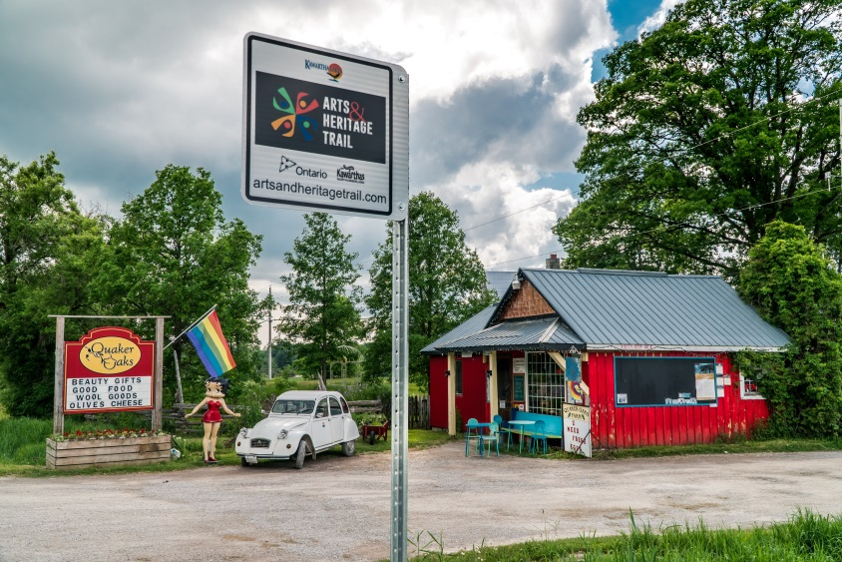
THE ARTS & HERITAGE TRAIL
50 cultural destinations
25 arts destinations
19 heritage destinations
3 natural heritage destinations
3 culinary culture destinations
2 experiences developed

Slide 13
ACKNOWLEDGEMENT OF THE SECTOR
The Guiding Assumptions of the May 2013 Master Cultural Plan reads:
In pursuing this Vision, the Council of the City of Kawartha Lakes embraces the following. We see:
Creativity and culture as increasingly important drivers in growing and diversifying the economy
Volunteers as fundamental to the cultural life of our community and a symbol of civic pride and commitment
Our combined natural and cultural environments as key to the quality of place that attracts people and investment
The growing cultural diversity of our community as a source of vitality and value the rich history and culture of Aboriginal communities

Slide 14
Artists and creators as essential sources of new ideas, innovation and technologies important to our future
Our history and culture as a source of identity for individual communities and the city as a whole
Our cultural assets as essential to building vibrant downtowns that are the social and economic hubs of our communities
A community in which cultural programs and activities are accessible to all residents through all phases of life
A municipality that integrates culture into all aspects of planning and decision-making
A municipality that values and supports strong cultural organizations working together toward shared goals

Slide 15
CURRENT STATUS OF THE SECTOR
The external environment has changed since the consultations for the Cultural Master Plan were conducted in 2011-2012
The 10 year plan is at the 5 year point and requires a Refresh that takes into consideration some of the following factors and sets new Strategic Priorities that align with the City’s 10 year Financial Plan
Under the current Cultural Master Plan there is a Strategic Priority of Increasing Capacity in the Sector
Organizations need training in Board recruitment, Board relations, financial planning, risk management, marketing and philanthropy, HR management of not-for-profits, government relations and grant writing, and legal compliance, to name a few
Many organizations require professional staff to work with volunteers, and provide day-to-day management, and continuity with stakeholders, donors and funders

Slide 16
There is a Vision for a cultural community hub and seed funding of $50,000 to initiate a Feasibility Study, however additional funds are required in order to launch the study, which will consider community needs, site locations, business models and a governance structure, in addition to financial feasibility
Arts & Heritage Trail has grown in membership and stature but current grant funding ends September 2018
Cultural Tourism is recognized by CKL as an important economic driver and KLAC has existed for 3.5 years and has experienced Board members who can partner with the City as advisors
Today and going forward, the need is urgent
Cultural and heritage organizations are often in crisis mode
to manage and fund their operations

Slide 17
GOING FORWARD
The cultural tourism of the City of Kawartha Lakes will not bring economic benefit to our community without investment and effective management
Investment with effective management will allow our cultural institutions to grow from providing static experiences to experiential experiences

Slide 18
INVESTMENT, THE NEXT STEP
It is the recommendation of the Kawartha Lakes Arts Council with the support of the Kawartha Lakes Heritage Network
that we ask Council to support the following:

Slide 19
2019 BUDGET
Expand on the current funding model that is in place for Maryboro Lodge/Fenelon Museum to include similar funding for comparable cultural organizations using eligibility criteria developed by a proposed Steering Committee

Slide 20
MUNICIPAL LEADERSHIP
Increase the number of City cultural staff positions in Economic Development one position to the following four positions:
Senior Leader, Culture
Heritage Planner – currently proposed by Development Services
Cultural Organizations & Arts & Heritage Trail Programmer
Administrative Assistant – to be shared with KLAC and KLHN

Slide 21
STEERING COMMITTEE
A steering committee of the following be created to meet immediate needs in the cultural sector, develop funding eligibility criteria for core funding and develop a Municipal Cultural Plan that meets the specific needs of the CKL:
Senior Leader, Culture
Heritage Planner
The Cultural Organizations & Arts & Heritage Trail Programmer
City Councilors (number to be determined)
Members from the Cultural Centre Committee
Shared administrative assistant

Slide 22
NEW CULTURAL CENTRE
In the next six months, the City and the Cultural Centre Committee become partners in creating and funding the development of a Request For Proposals (RFP) for a feasibility study for a future Community Cultural Hub/Community Complex

Slide 23
THANK YOU

